Slide 1
Clinical Evidence for the
Novel Topical Carboxy Gel: CO2Lift

Slide 2
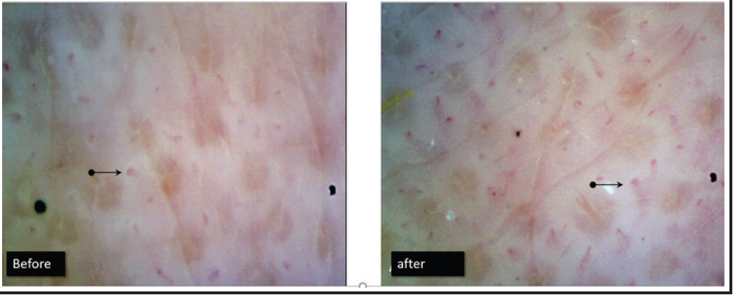
PROOF OF MECHANISM
CONCLUSION:
Carboxytherapy Topical Gel produced a reaction in the capillaries similar to that seen with CO2 injections into the skin. Oxygen concentration and micro-circulation increased and there was recovery of connective tissue.
MICROCIRCULATION IMPROVEED BY 28%
AFTER THE USE OF THE TRANSDERMAL CO2 GEL.
Leibaschoff GH, Coll L, Roberts WE. A Prospective Clinical and Instrumental Study on the Effects of a Transcutaneous Cosmeceutical Gel that is Claimed to Produce CO2. Surgical Technology International 2018; !2: 33-38

Slide 3
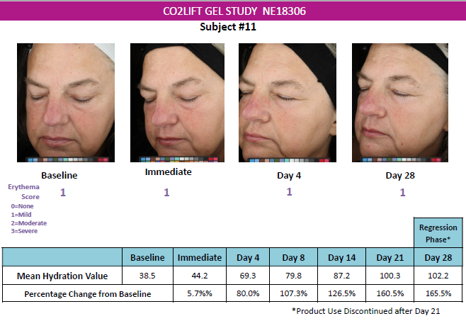
STANDALONE - HYDRATION
CONCLUSION:
Dramatically increased hydration ⬆117% compared to baseline post treatment for up to 3 week.
Draelos, Zoe. A Clinical Study to Assess the Efficacy of a Carboxy Mask on Facial Appearance Improvement. Aug 2022

Slide 4




STANDALONE – ELASTICITY + SKIN QUALITY
CONCLUSION:
The retraction time was the length of time in milliseconds (ms) required for the skin to snap back to its original conformation after distention by a vacuum pump. The retraction time decreased in a statistically significant manner at week 4 (-12%, p=0.004) and week 10 (-10%, p=0.05). This means that the skin exhibited better elastic properties. The elastic modulus, also known as Young’s modulus, is measured in megapascals (MPa) and is a measure of how ductile the skin is when stretched. The elastic modulus decreased indicating an improvement in the elasticity of the skin at weeks 4 (-26%) and 10 (-28)(p<0.001). This data indicates that the skin elasticity improved with the face mask resulting in better skin firmness and less sagging.
39% Luminosity
42% Radiance
30% Sagging
27% Pigmentation
24% Fine Lines
20% Wrinkles
26% Elasticity at W4,
28% at W10
24% Fine Lines
20% Wrinkles
Week 1: 3 treatments, Weeks 2-4: 1 treatment each
Draelos, Zoe. A Clinical Study to Assess the Efficacy of a Carboxy Mask on Facial Appearance Improvement. Aug 2022

Slide 5
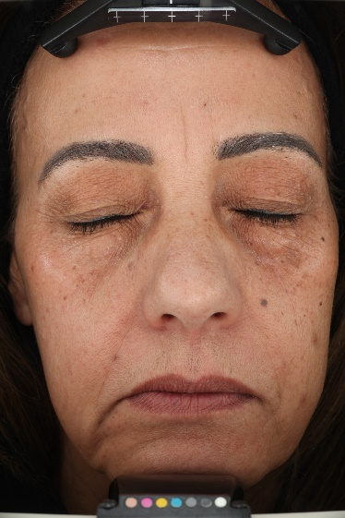
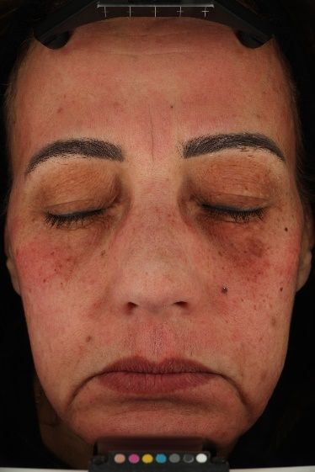
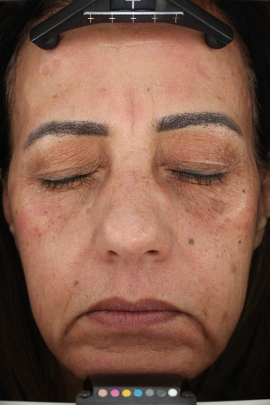
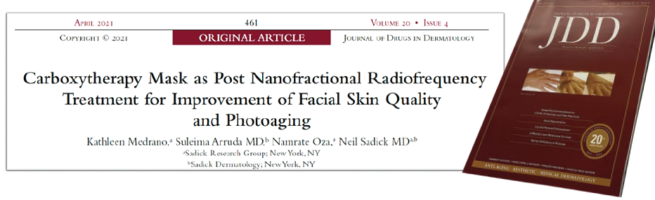
POST TREATMENT
CONCLUSION:
Reduced downtime, speedy healing, improved clinical outcomes, and higher patient satisfaction.
PRE-TREATMENT
POST-TREATMENT
45-MIN POST CARBOXY GEL
MICRONEEDING RADIOFREQUENCY +
1 TOPICAL CARBOXY TREATMENT
CARBOXY GEL APPLIED IMMEDIATELY POST PROCEDURE
Change from baseline
Journal of Drugs in Dermatology, N. Sadick et al April 2021

Slide 6
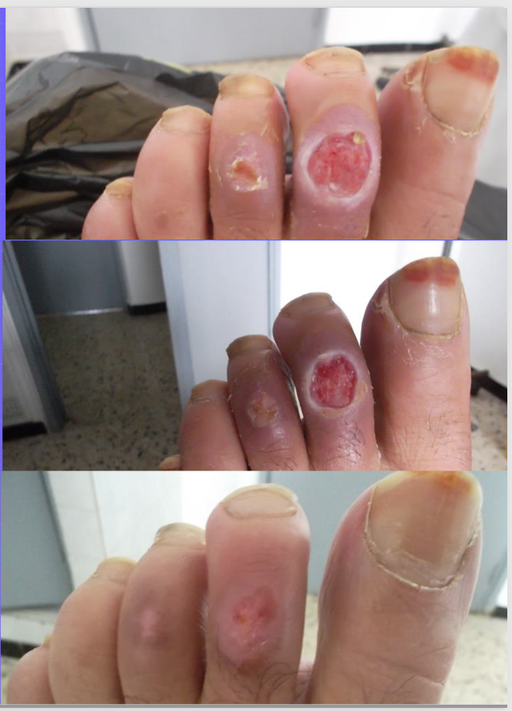
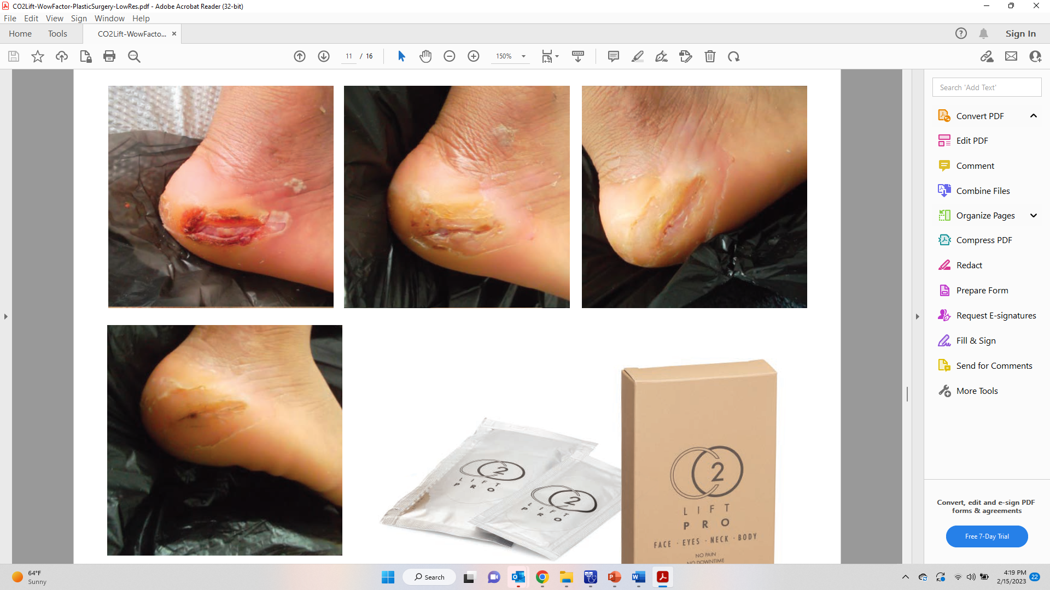
WOUND HEALING
CONCLUSION:
100% Re-epithelialization or complete healing within 1 month for 10 diabetic ulcer patients.
  52- year-old patient with Type 2 Diabetes on Insulin
  3 CO2Lift Pro Treatments per week for 4 weeks
Type 1 Diabetes - Diabetic Ulcer
4 months with non-healing ulcer.
3 CO2Lift Pro Treatments per week for 4 weeks
All photos courtesy of Dr. Gustavo Leibaschoff

Slide 7
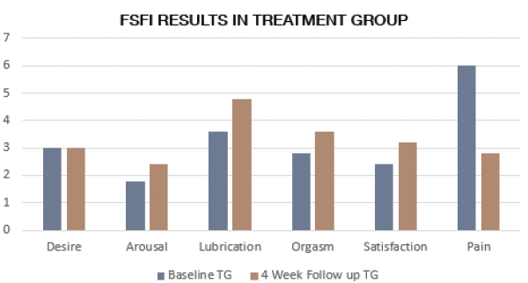
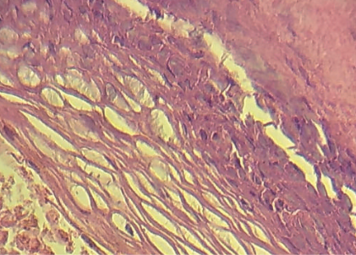
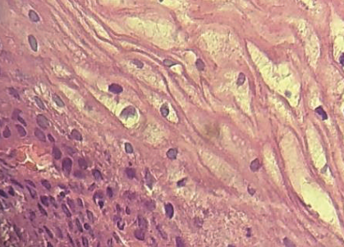
VULA / VAGINAL ATROPHY
CONCLUSION:
Results suggest that the transdermal CO2 gel is beneficial for affected tissues in VVA and reduces the signs and symptoms of GSM.
HISTOLOGICAL EVIDENCE: CO2LIFTV IMPACT ON VAGINAL TISSUE
Before treatment: pre-dominance of basal & parabasal cells
Post- treatment (10X): thicker epithelium with maturation
Notes:
EVIDENCE OF MOA
Increases the thickness of the skin. When make tissue thicker, if thin sex is more painful. Improves the natural lube and sensitivity. Bulding back the tissue.

